Slide 1

DIGITAL FORENSICS
DR. NILAKSHI JAIN
Email ID: nilakshijain1986@gmail.com

Slide 2
6.1 Media Analysis Concepts
6.2 Partitioning & Disk Layouts
6.3 Special Containers
6.4 Hashing
6.5 Carving
6.6 Forensic Imaging
CHAPTER SIX
DISK AND FILE SYSTEM ANALYSIS

Slide 3
Media analysis concepts
6.1 Media Analysis Concepts
6.2 Partitioning & Disk Layouts
6.3 Special Containers
6.4 Hashing
6.5 Carving
6.6 Forensic Imaging
Media analysis goal includes identifying, extracting, and analyzing these files and the file systems they lie upon.
Identification includes finding which active and deleted files are available in a volume.
Extraction is the retrieving relevant file data and metadata.
Analysis is the process in which we can apply our intelligence to the dataset and ideally come up with meaningful results.

Slide 4
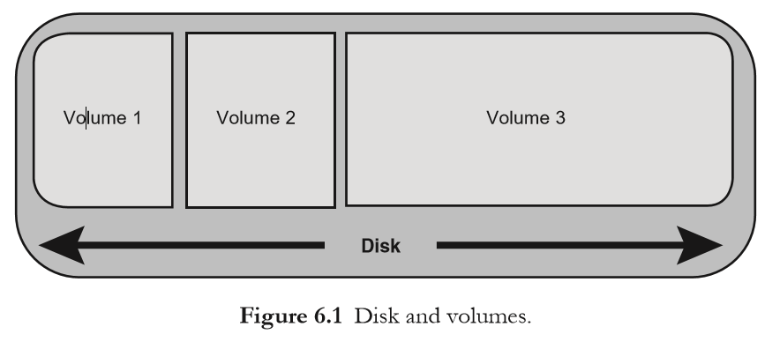
Media analysis concepts
File System Abstraction Model
In the File System Forensic Analysis, a file system abstraction model is used while the functions of file systems and the artifacts generated by these functions are described.
Single disk can contain several volumes, or a volume may span several disks, depending on configuration. The term “partition” is usually used interchangeably for a volume; Carrier makes a distinction wherein a “partition” is limited to a single physical disk, and a volume is a collection of one or more partitions. When put simply, a volume describes a number of sectors on a disk(s) in a given system.
6.1 Media Analysis Concepts
6.2 Partitioning & Disk Layouts
6.3 Special Containers
6.4 Hashing
6.5 Carving
6.6 Forensic Imaging

Slide 5
Partitioning and Disk Layouts
6.1 Media Analysis Concepts
6.2 Partitioning & Disk Layouts
6.3 Special Containers
6.4 Hashing
6.5 Carving
6.6 Forensic Imaging
The two elementary partitioning schemes being used these days are “Master Boot Record (MBR)” and “GUID Partition Table (GPT)”.
The GPT scheme was built up as a replacement for MBR scheme.
The MBR partitioning method permitted only four primary partitions and disks of up to 2 Terabytes.
The GPT format backs up disks up to 8 Zettabytes and 128 primary partitions, in addition to many other improvements.
The partition table is not likely to include any relevant information to most investigations.
When the partitioning structures are missing or corrupted, forensic analysis of the partition table is usually limited to recovery of volumes.

Slide 6
Partitioning and Disk Layouts
6.1 Media Analysis Concepts
6.2 Partitioning & Disk Layouts
6.3 Special Containers
6.4 Hashing
6.5 Carving
6.6 Forensic Imaging
Partition Identification and Recovery
Deleted or missing partitions can be identified by using the sigfind tool.
The tool contains a number of predefined data structure templates that locate the tell-tale marks of a partition table or file system header.
Redundant Array of Inexpensive Disks
Redundant Array of Inexpensive Disks (RAID) is designed to take multiple physical disks and address them as a single logical unit. The most commonly used basic RAID levels are as follows:
RAID 0: It refers to a setup of at least two disks that are “striped” at a block level.
RAID 1: It is the opposite of RAID 0—blocks are mirrored across pairs of drives.
RAID 5: It needs at least three disks and performs striping across multiple disks in addition to creating parity blocks.
Also, there are “nested” or “hybrid” RAID setups that combine two of these RAID levels in sequence. For example, a RAID 50 or 5+0 set can be a pair of RAID5 sets that are subsequently striped.

Slide 7
Special Containers
6.1 Media Analysis Concepts
6.2 Partitioning & Disk Layouts
6.3 Special Containers
6.4 Hashing
6.5 Carving
6.6 Forensic Imaging
Along with file systems in volumes on physical media, you may have to deal with file systems in other containers. One such example is the Macintosh-specific DMG container which has been discussed in the previous section. The other two major containers are Virtual Machine Disk Images and Forensic Containers.
Virtual Machine Disk Images :
Virtualization applications, such as VMWare, VirtualBox, Virtual PC, and QEMU allow users to run a full “virtual machine” within the host operating system.
Usually, they store the file systems used by these virtual machines as virtual disk images—container files that act as a “disk” for purposes of virtualization software.
A VMWare virtual disk is defined using a descriptor file that defines the file(s) that makes up that particular virtual disk, also specifications of the “disk” being presented to the virtual machine.
Files containing changes from the base image called delta links are created as users create snapshots of a virtual machine, and a new descriptor file containing information about the base and delta files is created.

Slide 8
Special Containers
6.1 Media Analysis Concepts
6.2 Partitioning & Disk Layouts
6.3 Special Containers
6.4 Hashing
6.5 Carving
6.6 Forensic Imaging
Forensic Containers
Container formats more towards forensic imaging have some functionality above and beyond what we get with a raw disk image.
EWF/E01:
Expert Witness Format (EWF) is the most commonly used forensic container format that is sometimes referred to as the “E01” format after its default extension.
This “format” has changed slightly from one release of EnCase to the next and it is not an open standard.
The EWF format supports compression, split files, and it also stores case metadata (that includes an MD5 or SHA1 hash of the acquired image) in a header data structure which is found in the first segment of the image file.

Slide 9
Special Containers
6.1 Media Analysis Concepts
6.2 Partitioning & Disk Layouts
6.3 Special Containers
6.4 Hashing
6.5 Carving
6.6 Forensic Imaging
AFF
The AFF is an open-source format used for storing disk images for forensics and any relevant metadata. AFF is implemented in the LibAFF package that we have installed previously. AFF image files is supported by The Sleuth Kit through this library.
AFF images is stored in one of the following three methods:
AFF: This is the default format of an AFF container; It is a single image file containing forensic data and case metadata.
AFD: This format contains metadata in the image, but it splits the image file into fixed-size volumes. This can be useful when archiving images or transporting via size-limited file systems or media.
AFM: This format stores the image file as a single and solid container, but it stores metadata in an external file.

Slide 10
HASHING
6.1 Media Analysis Concepts
6.2 Partitioning & Disk Layouts
6.3 Special Containers
6.4 Hashing
6.5 Carving
6.6 Forensic Imaging
A cryptographic hash function takes an arbitrary amount of data as input and then it returns a fixed-size string as output. Hash of data is the resulting value.
Common hashing algorithms that are used during a forensic examination include SHA1 and MD5.
For hash functions used in forensic functions, modification of a single bit of input data will produce a radically different hash value as output.
As a hash is calculated by processing the content of a file, matching hashes across various files can be used to find renamed files, or to remove “known good” files from the set of data that has to be examined.
. For simply generating a hash of a single file, the sha1sum or md5sum programs present on nearly Linux systems are sufficient. Using these programs to generate hash lists of multiple files or multiple nested directories of files can be quite tiring.
To solve this issue, Jesse Kornblum has produced the md5deep and hashdeep utilities.
Md5deep is a suite of hashing utilities created to recurse through a set of input files or directories and produce hash lists for these.

Slide 11
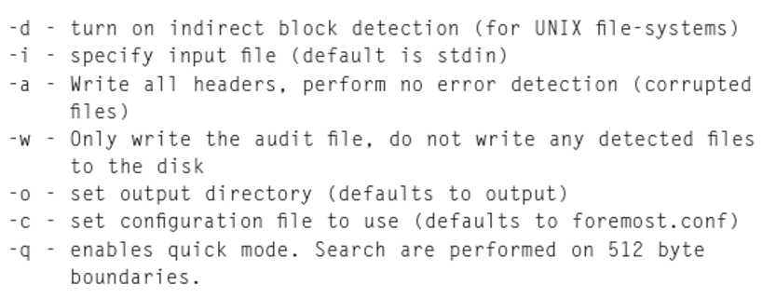
Carving
6.1 Media Analysis Concepts
6.2 Partitioning & Disk Layouts
6.3 Special Containers
6.4 Hashing
6.5 Carving
6.6 Forensic Imaging
The process of carving involves searching a data stream for file headers and magic values, determining (or guessing) the file end point, and saving this sub stream out into a carved file.
Foremost
It uses defined footers, headers, and knowledge of the internal structures for supported file types to aid in carving.
Options that may be particularly important include:

Slide 12
Forensic Imaging
6.1 Media Analysis Concepts
6.2 Partitioning & Disk Layouts
6.3 Special Containers
6.4 Hashing
6.5 Carving
6.6 Forensic Imaging
A good forensic imaging process creates an exact duplicate (or a container that holds an exact duplicate) of the source media under investigation.
The primary reason is to provide an exact copy of original media to test.
The actual weapon is the best evidence for the traditional analyst.
We minimize our opportunities to alter the original accidentally by only accessing the original media once to generate our forensic image.
Another benefit of working on an image is if we make a mistake and somehow end up altering the image file in some way, we can generate a new exact duplicate from the intact original media.

Slide 13
Forensic Imaging
6.1 Media Analysis Concepts
6.2 Partitioning & Disk Layouts
6.3 Special Containers
6.4 Hashing
6.5 Carving
6.6 Forensic Imaging
Deleted Data:
One of the reasons examiners use forensic imaging is for completeness.
Most volumes contain reams of potentially interesting data outside of the viewable, allocated files on a mounted file system. This includes several categories of “deleted data.”
1.Deleted files:
They are the “most recoverable.” Generally, this refers to files that have been “unlinked”—the file name entry is no longer presented when a user views a directory, and the file name,metadata structure, and data units are marked as “free.”
2. Orphaned files:
They are similar to deleted files except the link between the file name and metadata structure is no longer accurate.
3.Unallocated files:
They have had their once-allocated file name entry and associated metadata structure have become unlinked and/or reused.
4. Overwritten files:
They have had one or more of their data units reallocated to another file.

Slide 14
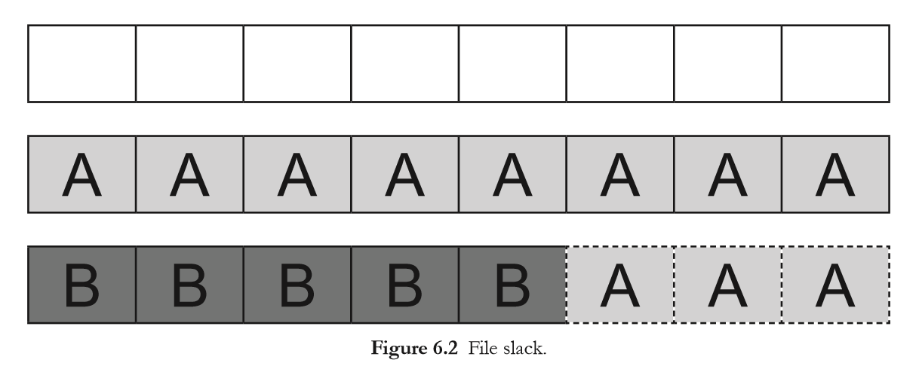
Forensic Imaging
6.1 Media Analysis Concepts
6.2 Partitioning & Disk Layouts
6.3 Special Containers
6.4 Hashing
6.5 Carving
6.6 Forensic Imaging
File Slack
Different file systems and operating systems handle this differently, but generally the process goes:
The cluster to be used is marked as “allocated” and assigned to the file’s metadata structure.
The “a” followed by 511 null bytes (hex 00) are placed in the first sector. We did not state how the next seven sectors are written to the disk will be noted by Astute readers. That’s not an oversight—they are not written to the disk. They retain whatever data were last stored in them during their previous allocation. This is what is known as slack space or file slack.

Slide 15
Forensic Imaging
6.1 Media Analysis Concepts
6.2 Partitioning & Disk Layouts
6.3 Special Containers
6.4 Hashing
6.5 Carving
6.6 Forensic Imaging
dd
The dd command is the most basic open-source tool available to create a forensic image. Because it is almost universally present on any operating system like Unix and is the basis for several other forensic imaging utilities, learning its operation is valuable to any examiner.
Dcfldd
While dd can and has been used to acquire forensically sound images, versions of dd are available that are specifically designed for forensic use. The first of these to be examined is dcfldd, created for the Defense Computer Forensics Laboratory by Nick Harbour. The dcfldd project is forked from GNU dd, so its basic operation is quite similar.
dc3dd
It is forensically oriented version created by Jesse Kornblum for the Department of Défense Cyber Crime Center. dc3dd is developed as a patch applied to GNU dd, rather than a fork, so dc3dd is able to incorporate changes made in the mainline dd more rapidly than dcfldd. dc3dd has all of the same extended features found in dcfldd and has core dd features currently absent in the latest dcfldd release.

Slide 16
Dr. Nilakshi Jain
Thank you
Email ID : nilakshijain1986@gmail.com

